Slide 1
Data Structures & Algorithms
Week 12: Heaps

Slide 2
Outline
Introduction
Binary Heap
Maintaining Heaps in Arrays
Max Heap
Min Heap
Applications of Heaps
Heap Sort
Priority Queues

Slide 3
Introduction
A heap is a tree-based data structure in which all the nodes of the tree are in a specific order.
For example, if X is the parent node of Y, then the value of X follows a specific order with respect to the value of Y and the same order will be followed across the tree.
The maximum number of children of a node in a heap depends on the type of heap.
In the more commonly-used heap type, there are at most 2 children of a node and it's known as a Binary heap.

Slide 4

Binary Heap
In binary heap, if the heap is a complete binary tree with N nodes, then it has smallest possible height which is logN .
In the diagram above, you can observe a particular sequence, i.e. each node has greater value than any of its children.

Slide 5
Example
Suppose there are N Jobs in a queue to be done.
Each job has its own priority.
The job with maximum priority will get completed first than others.
At each instant, we are completing a job with maximum priority and at the same time we are also interested in inserting a new job in the queue with its own priority.

Slide 6
Example (cont.)
At each instant we have to check for the job with maximum priority to complete it and also insert if there is a new job.
This task can be very easily executed using a heap by considering N jobs as N nodes of the tree.

Slide 7
Maintaining Heap in Arrays
An array can be used to simulate a tree in the following way.
If we are storing one element at index i in array Arr, then its parent will be stored at index i/2 (unless its a root, as root has no parent) and can be accessed by Arr[i/2].
Its left child can be accessed by Arr[2∗i] and its right child can be accessed by Arr[2∗i+1].
Index of root will be 1 in an array.

Slide 8
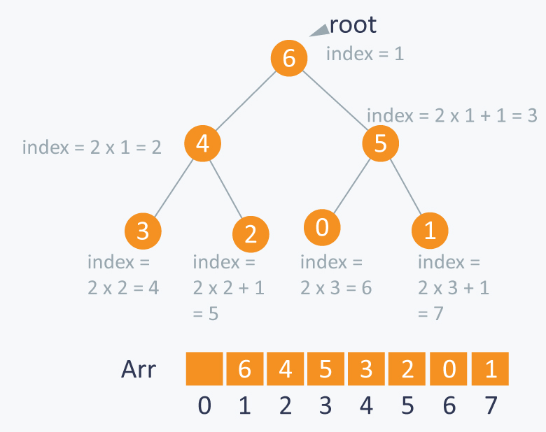
Maintaining Heap in Arrays
We can use an array to store the nodes of the tree. Let’s say we have 7 elements with values {6, 4, 5, 3, 2, 0, 1}.

Slide 9
Types of Heaps
Max Heap: In this type of heap, the value of parent node will always be greater than or equal to the value of child node across the tree and the node with highest value will be the root node of the tree.
To convert an array into a heap structure is the following, do as following:
Pick a node in the array, check if the left sub-tree and the right sub-tree are max heaps, in themselves and the node itself is a max heap (it’s value should be greater than all the child nodes)

Slide 10
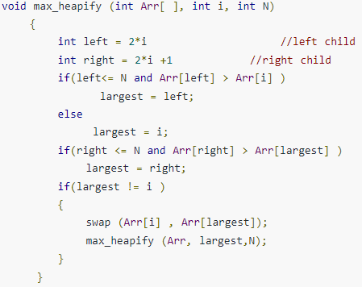
Implementation of Max Heap
Complexity: O(logN)

Slide 11
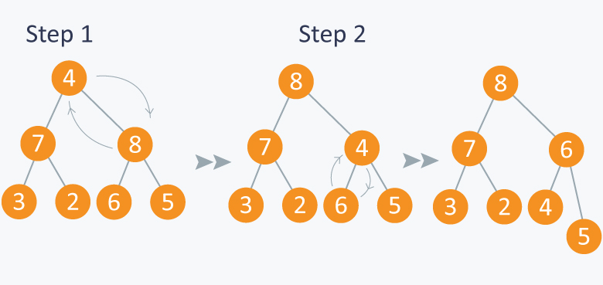
Example: Max Heap
First node (root node) is violating property of max-heap as it has smaller value than its children, so we are performing max_heapify function on this node having value 4.

Slide 12
Example: Max Heap (cont.)
As 8 is greater than 4, so 8 is swapped with 4 and max_heapify is performed again on 4, but on different position.
Now in step 2, 6 is greater than 4, so 4 is swapped with 6 and we will get a max heap, as now 4 is a leaf node.
Further call to max_heapify will not create any effect on heap.

Slide 13
Property of Max Heap
A N element heap stored in an array has leaves indexed by N/2+1, N/2+2 , N/2+3 …. upto N.
Lets take example of 7 elements having values {8, 7, 6, 3, 2, 4, 5}.
So you can see that elements 3, 2, 4, 5 are indexed by N/2+1 (i.e 4), N/2+2 (i.e 5 ) and N/2+3 (i.e 6) and N/2+4 (i.e 7) respectively.

Slide 14
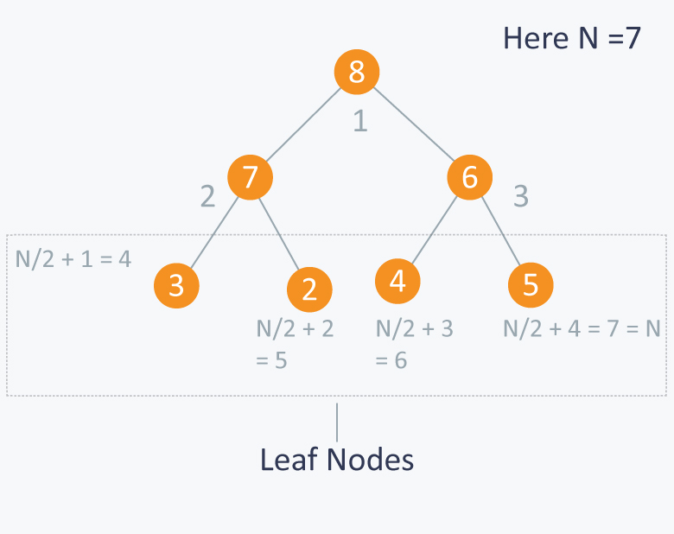
Property of Max Heap (cont.)

Slide 15
Building Max Heap
Now let’s say we have N elements stored in the array Arr indexed from 1 to N.
They are currently not following the property of max heap.
So we can use max-heapify function to make a max heap out of the array.

Slide 16
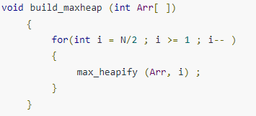
Building Max Heap
From the Max Heap property we observed that elements from Arr[N/2+1] to Arr[N] are leaf nodes, and each node is a 1 element heap. We can use max_heapify function in a bottom up manner on remaining nodes, so that we can cover each node of tree.
Complexity: O(N)

Slide 17
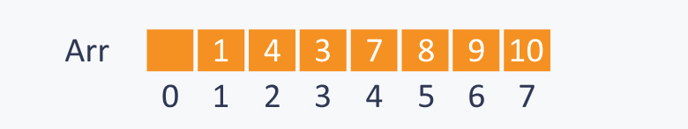
Building Max Heap - Example
Suppose you have 7 elements stored in array Arr.
Here N=7, so starting from node having index N/2=3, (also having value 3 in the above diagram), we will call max_heapify from index N/2 to 1.

Slide 18
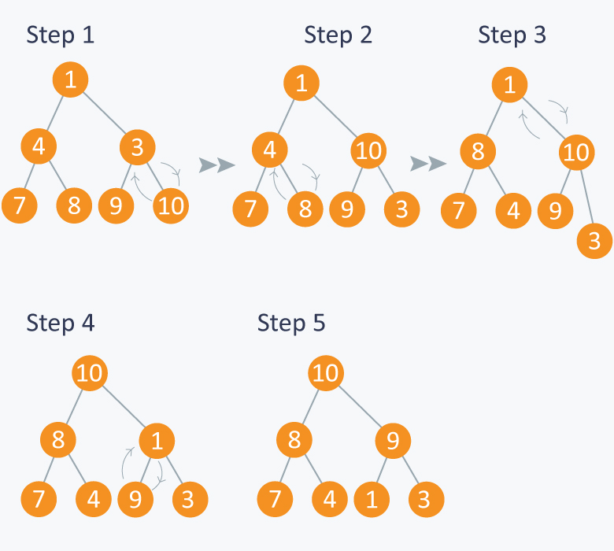
Building Max Heap – Example (cont.)
In step 1, in max_heapify(Arr, 3), as 10 is greater than 3, 3 and 10 are swapped and further call to max_heap(Arr, 7) will have no effect as 3 is a leaf node now.

Slide 19
Building Max Heap – Example (cont.)
In step 2, calling max_heapify(Arr, 2) , (node indexed with 2 has value 4) , 4 is swapped with 8 and further call to max_heap(Arr, 5) will have no effect, as 4 is a leaf node now.

Slide 20
Building Max Heap – Example (cont.)
In step 3, calling max_heapify(Arr, 1) , (node indexed with 1 has value 1 ), 1 is swapped with 10.

Slide 21
Building Max Heap – Example (cont.)
Step 4 is a subpart of step 3, as after swapping 1 with 10, again a recursive call of max_heapify(Arr, 3) will be performed , and 1 will be swapped with 9. Now further call to max_heapify(Arr, 7) will have no effect, as 1 is a leaf node now.

Slide 22
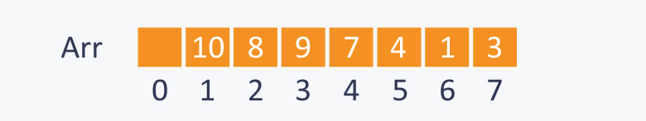
Building Max Heap – Example (cont.)
In step 5, we finally get a max- heap and the elements in the array Arr will be:

Slide 23

Types of Heaps
Min Heap: In this type of heap, the value of parent node will always be less than or equal to the value of child node across the tree and the node with lowest value will be the root node of tree.
Each node has a value smaller than the value of their children.

Slide 24
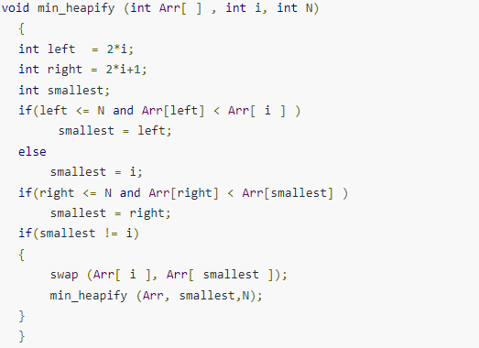
Implementation of Min Heap
We can perform same operations as performed in building max_heap.
First we will make function which can maintain the min heap property, if some element is violating it.

Slide 25

Example: Min Heap
Suppose you have elements stored in array Arr {4, 5, 1, 6, 7, 3, 2}. As you can see in the diagram below, the element at index 1 is violating the property of min -heap, so performing min_heapify(Arr, 1) will maintain the min-heap.

Slide 26
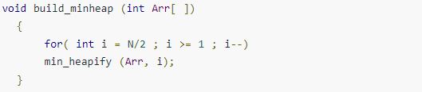
Building Min Heap
We will run the above function on remaining nodes other than leaves as leaf nodes are 1 element heap.
Complexity: O(N)

Slide 27
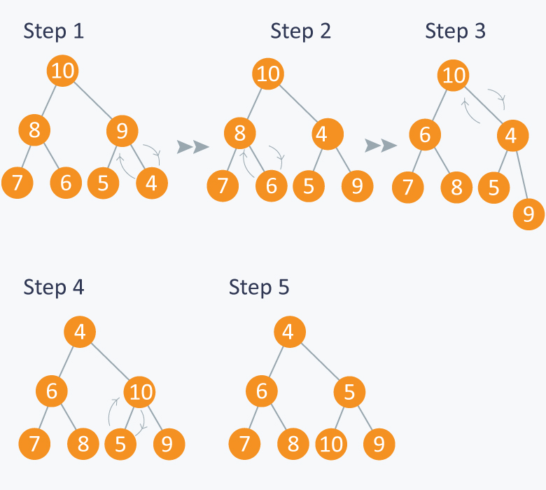
Example: Building Min Heap
Consider elements in array {10, 8, 9, 7, 6, 5, 4} . We will run min_heapify on nodes indexed from N/2 to 1. Here node indexed at N/2 has value 9. And at last, we will get a min_heap.

Slide 28
Heaps as Partially ordered Trees
Heaps can be considered as partially ordered tree
As you can see in the above examples that the nodes of tree do not follow any order with their siblings(nodes on the same level).
They can be mainly used when we give more priority to smallest or the largest node in the tree as we can extract these node very efficiently using heaps.

Slide 29
Applications of Heaps
Heap Sort
Priority Queues

Slide 30
Heap Sort
We can use heaps in sorting the elements in a specific order in efficient time.
Let’s say we want to sort elements of array Arr in ascending order. We can use max heap to perform this operation.
Idea: We build the max heap of elements stored in Arr, and the maximum element of Arr will always be at the root of the heap.
Leveraging this idea we can sort an array in the following manner.

Slide 31
Heap Sort
Initially we will build a max heap of elements in Arr.
Now the root element that is Arr[1] contains maximum element of Arr. After that, we will exchange this element with the last element of Arr and will again build a max heap excluding the last element which is already in its correct position and will decrease the length of heap by one.
We will repeat the step 2, until we get all the elements in their correct position.

Slide 32
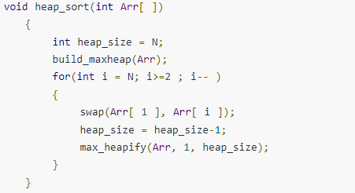
Heap Sort - Implementation
Suppose there are N elements stored in array Arr.
Complexity: As we know max_heapify has complexity O(logN), build_maxheap has complexity O(N) and we run max_heapify N−1 times in heap_sort function, therefore complexity of heap_sort function is O(NlogN).

Slide 33
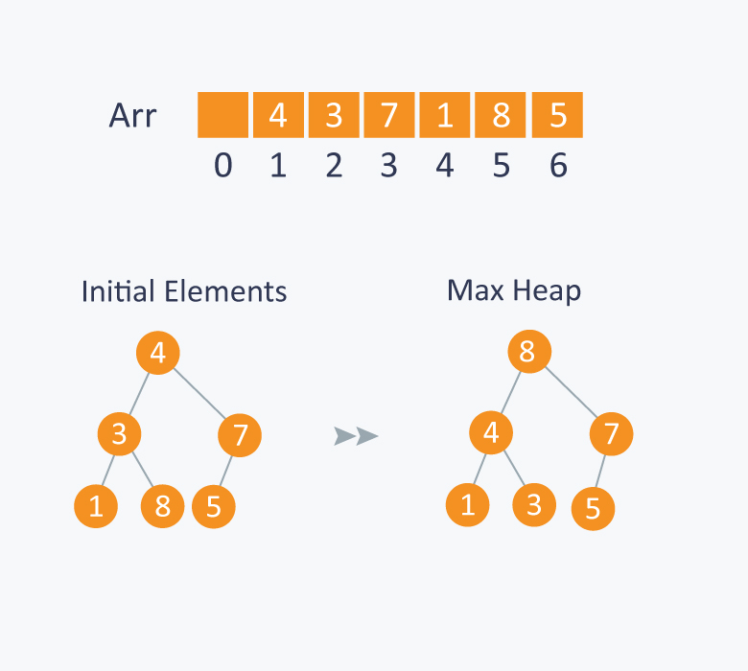
Heap Sort - Example

Slide 34
Heap Sort - Example
Step 1: 8 is swapped with 5. Step 2: 8 is disconnected from heap as 8 is in correct position now. Step 3: Max-heap is created and 7 is swapped with 3. Step 4: 7 is disconnected from heap. Step 5: Max heap is created and 5 is swapped with 1. Step 6: 5 is disconnected from heap. Step 7: Max heap is created and 4 is swapped with 3. Step 8: 4 is disconnected from heap. Step 9: Max heap is created and 3 is swapped with 1. Step 10: 3 is disconnected.

Slide 35
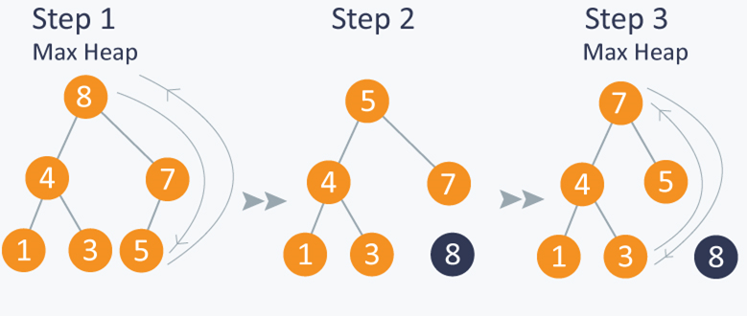
Heap Sort - Example

Slide 36
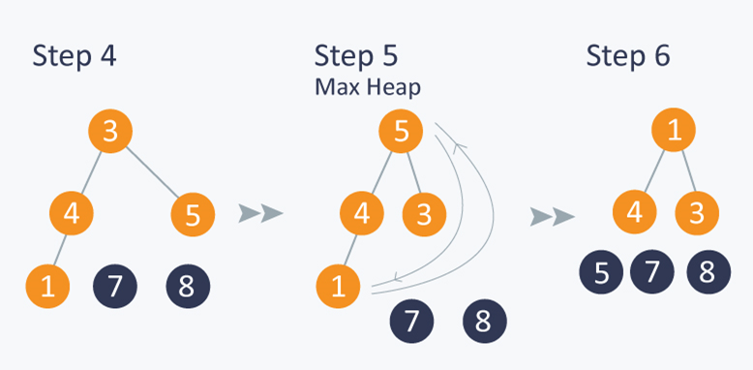
Heap Sort – Example (cont.)

Slide 37
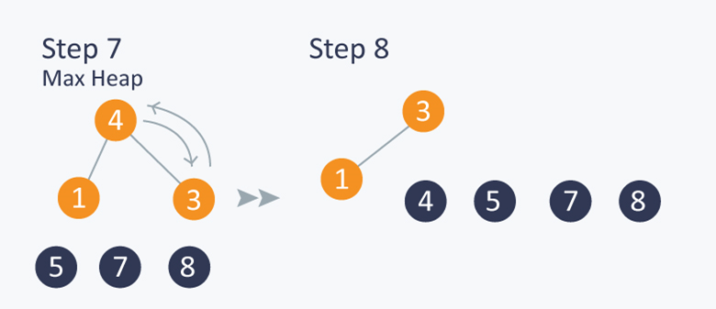
Heap Sort – Example (cont.)

Slide 38
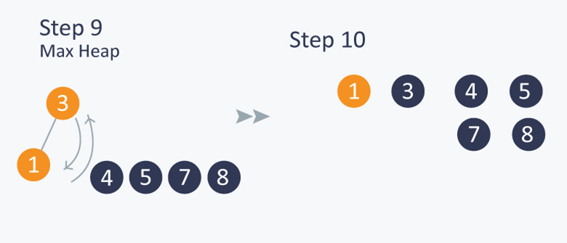
Heap Sort – Example (cont.)

Slide 39
Priority Queues
Priority Queue is similar to queue where we insert an element from the back and remove an element from front, but with a difference that the logical order of elements in the priority queue depends on the priority of the elements.
The element with highest priority will be moved to the front of the queue and one with lowest priority will move to the back of the queue.
Thus it is possible that when you enqueue an element at the back in the queue, it can move to front because of its highest priority.

Slide 40

Example - Priority Queue
Let’s say we have an array of 5 elements : {4, 8, 1, 7, 3} and we have to insert all the elements in the max-priority queue. First as the priority queue is empty, so 4 will be inserted initially.

Slide 41

Example - Priority Queue
Now when 8 will be inserted it will moved to front as 8 is greater than 4.

Slide 42

Example - Priority Queue
While inserting 1, as it is the current minimum element in the priority queue, it will remain in the back of priority queue.

Slide 43

Example - Priority Queue
Now 7 will be inserted between 8 and 4 as 7 is smaller than 8.

Slide 44

Example - Priority Queue
Now 3 will be inserted before 1 as it is the 2nd minimum element in the priority queue.

Slide 45
Building Priority Queue
Naive Approach:
Suppose we have N elements and we have to insert these elements in the priority queue.
We can use list and can insert elements in O(N) time and can sort them to maintain a priority queue in O(NlogN) time.

Slide 46
Building Priority Queue
Efficient Approach: We can use heaps to implement the priority queue. It will take O(logN) time to insert and delete each element in the priority queue.
Based on heap structure, priority queue also has two types max- priority queue and min - priority queue.

Slide 47
Building Max Priority Queue
Max Priority Queue is based on the structure of max heap and can perform following operations:
maximum(Arr) : It returns maximum element from the Arr.
extract_maximum (Arr) - It removes and return the maximum element from the Arr.
increase_val (Arr, i , val) - It increases the key of element stored at index i in Arr to new value val.
insert_val (Arr, val ) - It inserts the element with value val in Arr.

Slide 48

Building Max Priority Queue
Maximum :
Complexity: O(1)

Slide 49
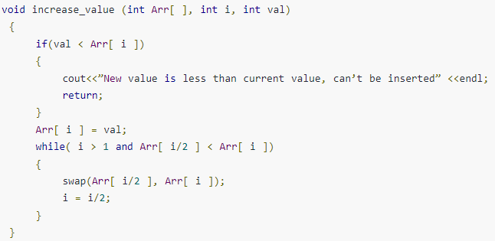
Building Max Priority Queue
Increase Value: In case increasing value of any node, it may violate the property of max-heap, so we may have to swap the parent’s value with the node’s value until we get a larger value on parent node.
Complexity : O(logN)

Slide 50
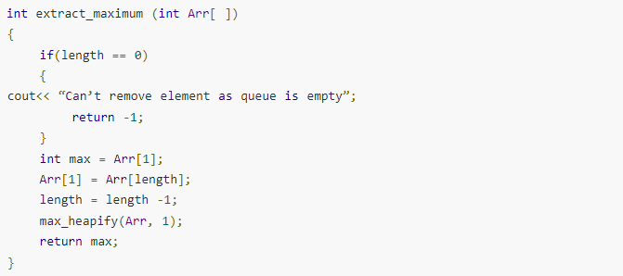
Building Max Priority Queue
Extract Maximum: In this operation, the maximum element will be returned and the last element of heap will be placed at index 1 and max_heapify will be performed on node 1 as placing last element on index 1 will violate the property of max-heapximum :
Complexity: O(logN)

Slide 51
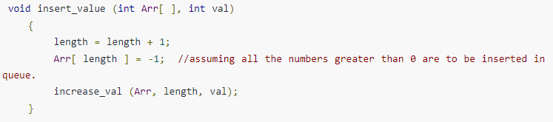
Building Max Priority Queue
Insert Value :
Complexity: O(logN)

Slide 52
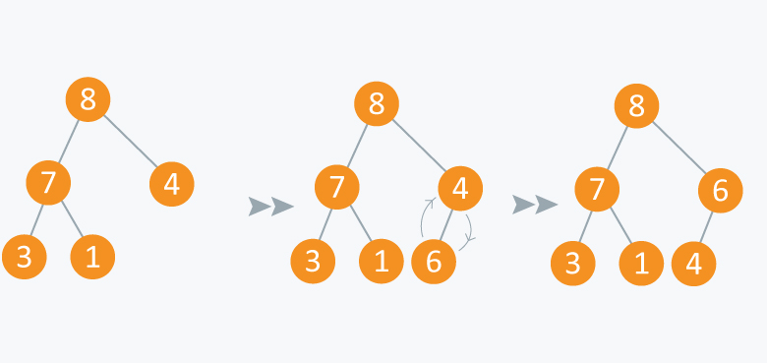
Example: Max Priority Queue
Initially there are 5 elements in priority queue. Operation: Insert Value(Arr, 6) Inserting another element having value 6 is violating the property of max-priority queue, so it is swapped with its parent having value 4, thus maintaining the max priority queue.

Slide 53
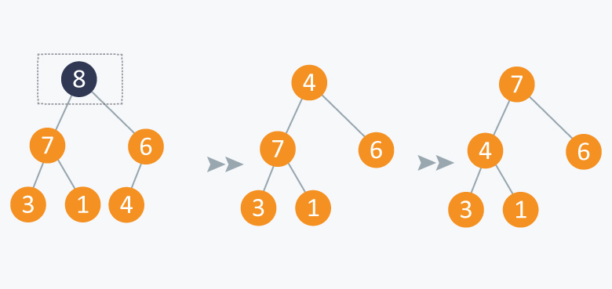
Example: Max Priority Queue
Operation: Extract Maximum: In the diagram below, after removing 8 and placing 4 at node 1, violates the property of max-priority queue. So max_heapify(Arr, 1) will be performed which will maintain the property of max - priority queue.

Slide 54
Scheduling of Jobs using P. Queue
When there are N jobs in queue, each having its own priority.
If the job with maximum priority will be completed first and will be removed from the queue, we can use priority queue’s operation extract_maximum here.
If at every instant we have to add a new job in the queue, we can use insert_value operation as it will insert the element in O(logN) and will also maintain the property of max heap.

Slide 55
Sources:
Heap Data Structure – GeeksforGeeks
Heaps/Priority Queues Tutorials & Notes | Data Structures | HackerEarth

